Slide 1
Co2 Emissions in cars
Project 389 – Group 4

Slide 2
project objective
The fundamental goal here is to model the CO2 emissions as a function of several car engine features.
Data Set Details:
The file contains the data for this example. Here the number of variables (columns) is 12, and the number of instances (rows) is 7385. In that way, this problem has the 12 following variables:
make, car brand under study.
model, the specific model of the car.
vehicle_class, car body type of the car.
engine_size, size of the car engine, in Liters.
cylinders, number of cylinders.
transmission, "A" for`Automatic', "AM" for ``Automated manual', "AS" for 'Automatic with select shift', "AV" for 'Continuously variable', "M" for 'Manual'.
fuel_type, "X" for 'Regular gasoline', "Z" for 'Premium gasoline', "D" for 'Diesel', "E" for 'Ethanol (E85)', "N" for 'Natural gas'.
fuel_consumption_city, City fuel consumption ratings, in liters per 100 kilometers.
fuel_consumption_hwy, Highway fuel consumption ratings, in liters per 100 kilometers.
fuel_consumption_comb(l/100km), the combined fuel consumption rating (55% city, 45% highway), in L/100 km.
fuel_consumption_comb(mpg), the combined fuel consumption rating (55% city, 45% highway), in miles per gallon (mpg).
co2_emissions, the tailpipe emissions of carbon dioxide for combined city and highway driving, in grams per kilometer.
Acceptance Criterion: Need to deploy the end results using Flask /Streamlit etc

Slide 3
workflow
Data Understanding and Cleaning: Understand the dataset, handle missing values, outliers, and inconsistencies.
Preprocessing: Transform data into a suitable format, including encoding categorical variables and scaling numerical features.
Exploratory Data Analysis (EDA): Explore relationships, patterns, and outliers in the data.
Feature Engineering and Multicollinearity Check: Create new features and check for multicollinearity among them.
Model Building:
Linear Regression
Random Forest
K-Nearest Neighbors (KNN)
Support Vector Regression (SVR)
Lasso and Ridge Regression
Cross-validation: Assess model performance using cross-validation.
Model Deployment:
Create a pickle file for the trained model.
Install Streamlit for building the web app.
Write the Python code for the app.
Deploy the app to a server or cloud platform.

Slide 4
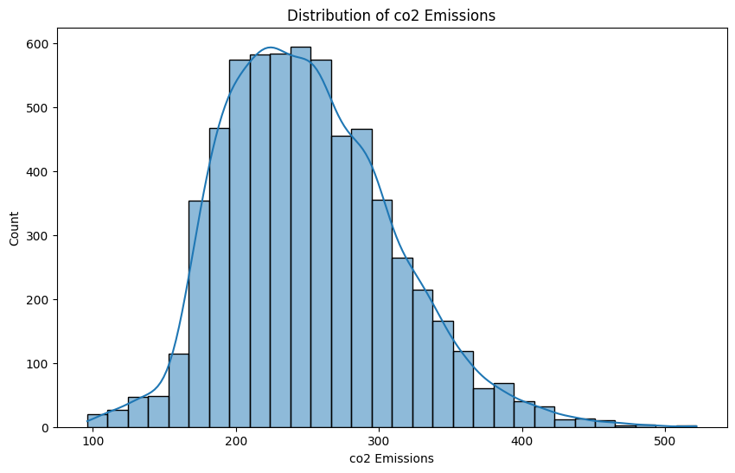
About the data
Data details
The dataset has 7385 entries(rows) and 12 variables(columns)
Numerical – 7 variables – 4 Float, 3 Int
Categorical – 5 variables – 5 object
co2_emissions is the target variable – Positive skewed.

Slide 5
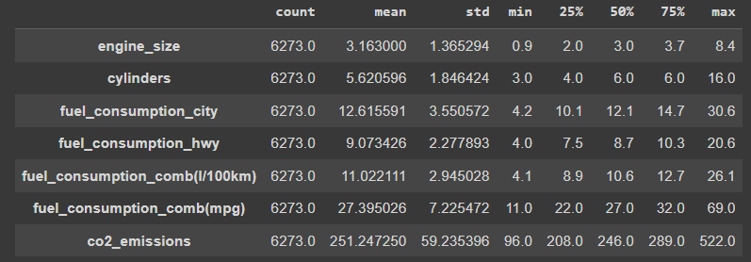
Description of Numerical data
Mean of CO2 emissions is 251
Median of CO2 emissions is 246
Positive Skewed dataset.
75% of the fuel consumption does not cross 15.
75% of cylinders are equal to or less than 6
Most of the variables are to contain outliers at right whisker.

Slide 6
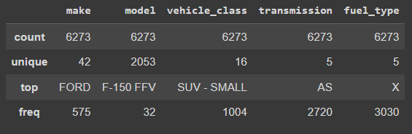
Description of Categorical data
Make - 42 unique car brands in our dataset, with 20 brands owning fewer than 100 cars and ranging from 2 to 575 cars per brand.
Model - 2053 models - majority of brands (32) have model counts between 10 and 100.
Vehicle class – 16 different classes with SUV-Small, Mid-size, and Compact being the most prevalent classes, each with over 900 cars.
5 transmission and 5 fuel types are available with AS the most used transmission and X being the most used fuel type

Slide 7
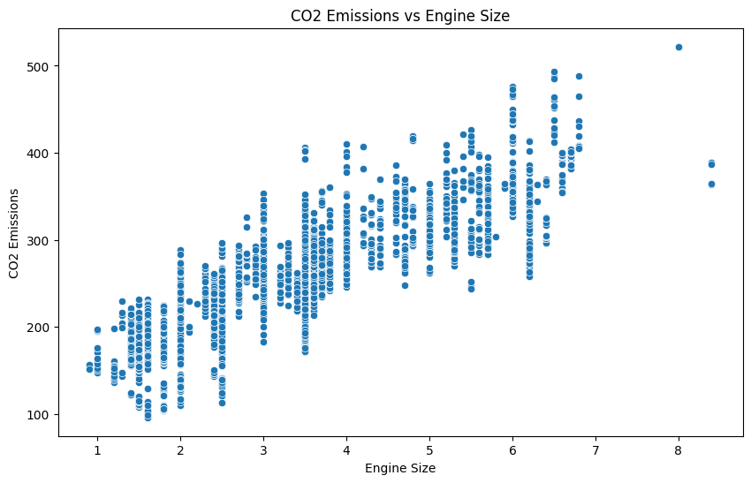
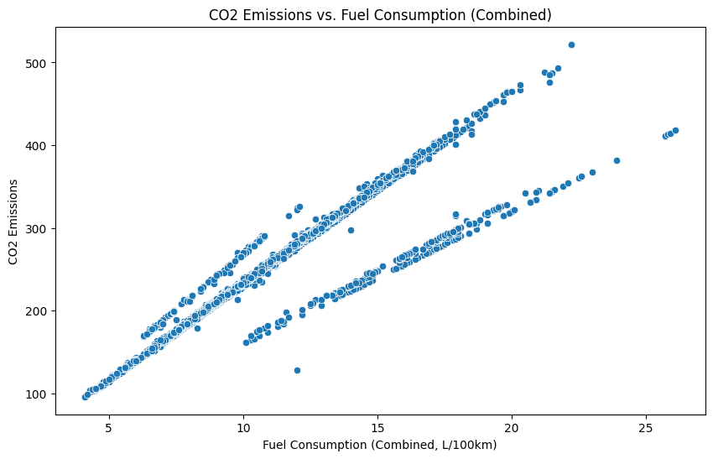
Target Variable
CO2 Emissions
The target variable is having a positive correlation with Engine, fuel consumption, fuel type, vehicle class, cylinders
Negative correlation with fuel consumption mpg and transmission
No correlation with make, model,

Slide 8
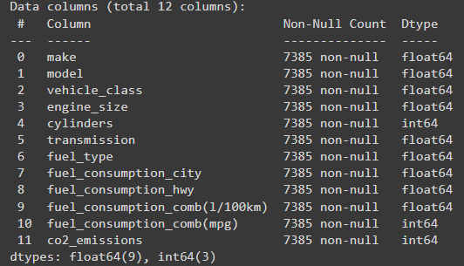
Data cleaning
There are no null values present in the data. print(df.isnull().sum())
5 object variables – make, model, vehicle_class, transmission, fuel_type – convered to float using LabelEncoder
1112 Duplicate entries have been found and removed. Df.shape() = (6273,12)
Index of the rows has been reset to 0 - df.reset_index(drop=True, inplace=True)

Slide 9
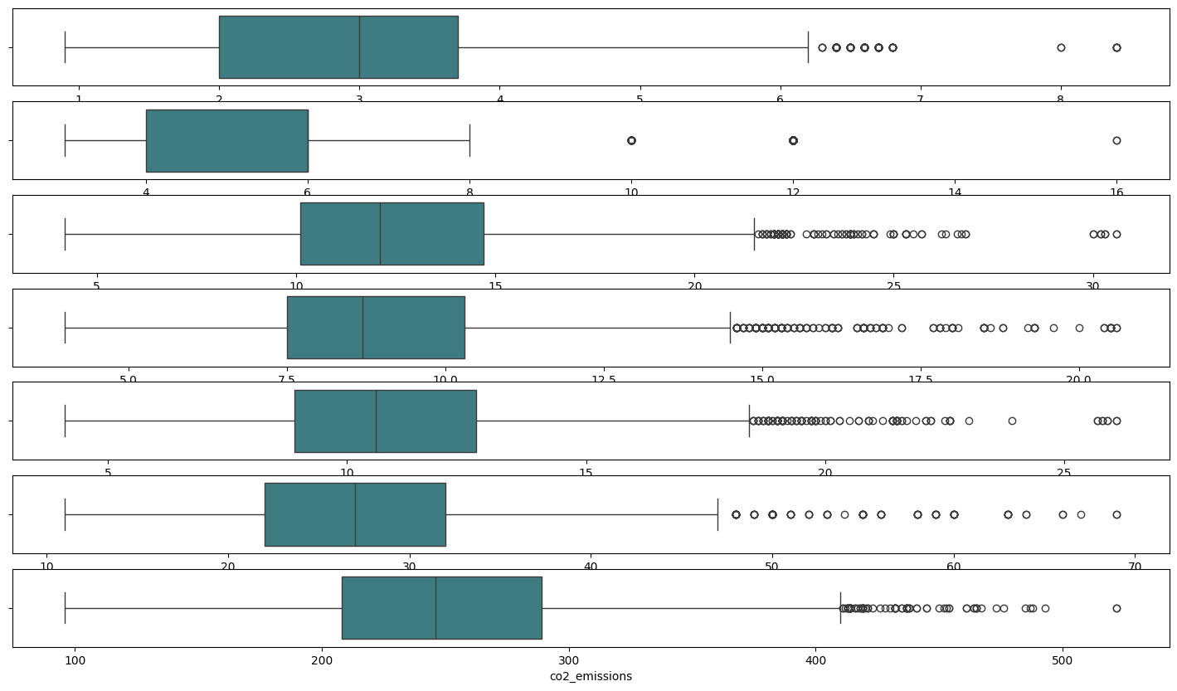
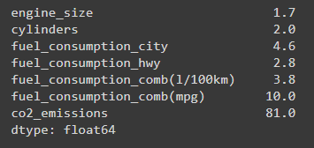
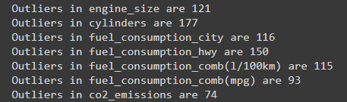
Outliers
Q1 and Q3 were defined and IQR for all the numerical values were found out.

Slide 10
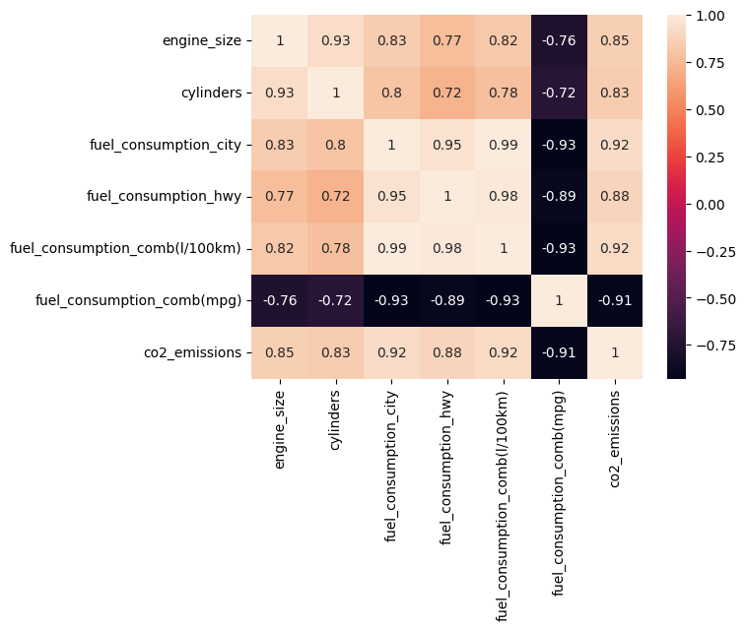
HeatMap of correlation
The heatmap shows the correlation matrix for various vehicle-related variables. Key points include:
Strong positive correlations:
Engine size with cylinders (0.93) and CO2 emissions (0.85).
Fuel consumption in the city with highway (0.95), combined l/100km (0.99), and CO2 emissions (0.92).
Strong negative correlations:
Fuel consumption (mpg) with city (-0.93), highway (-0.89), combined l/100km (-0.93), and CO2 emissions (-0.91).
The color intensity indicates the strength of the correlations, with darker colors representing stronger correlations.

Slide 11
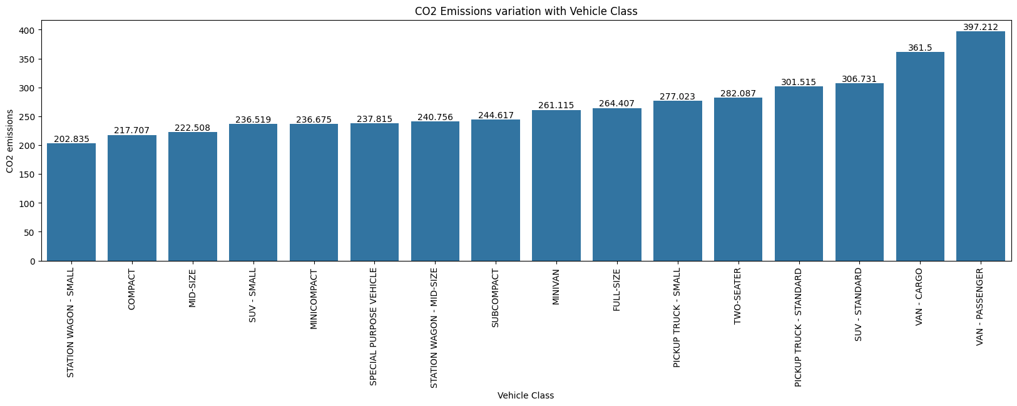
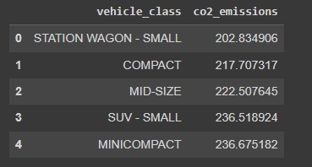
Average CO2 Emissions Vehicle class
Two seater has the highest emissions while station wagon small has the lowest emissions

Slide 12
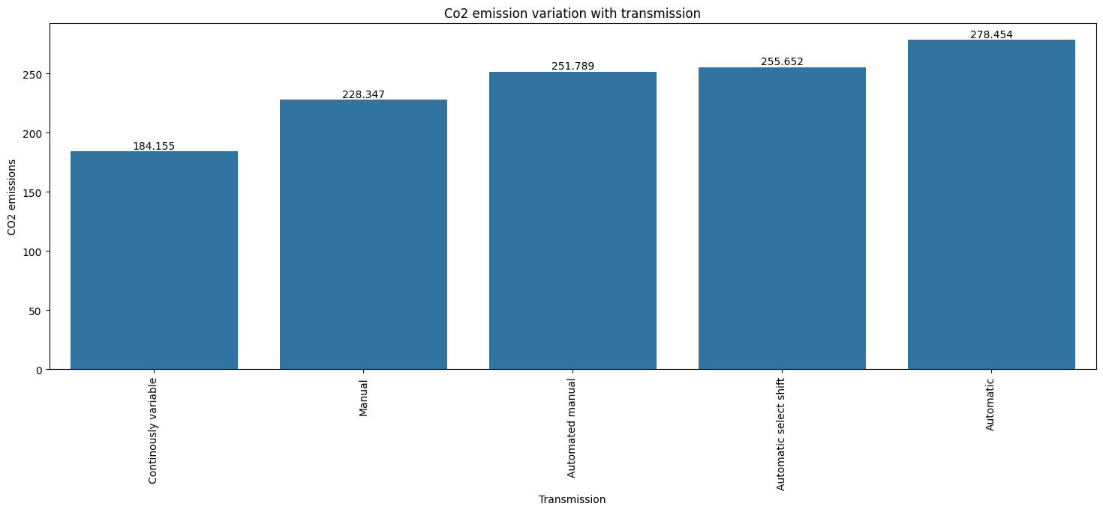
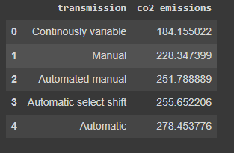
Average CO2 Emissions transmission
Automatic has the highest average emissions while continuously variable has the lowest emisison

Slide 13
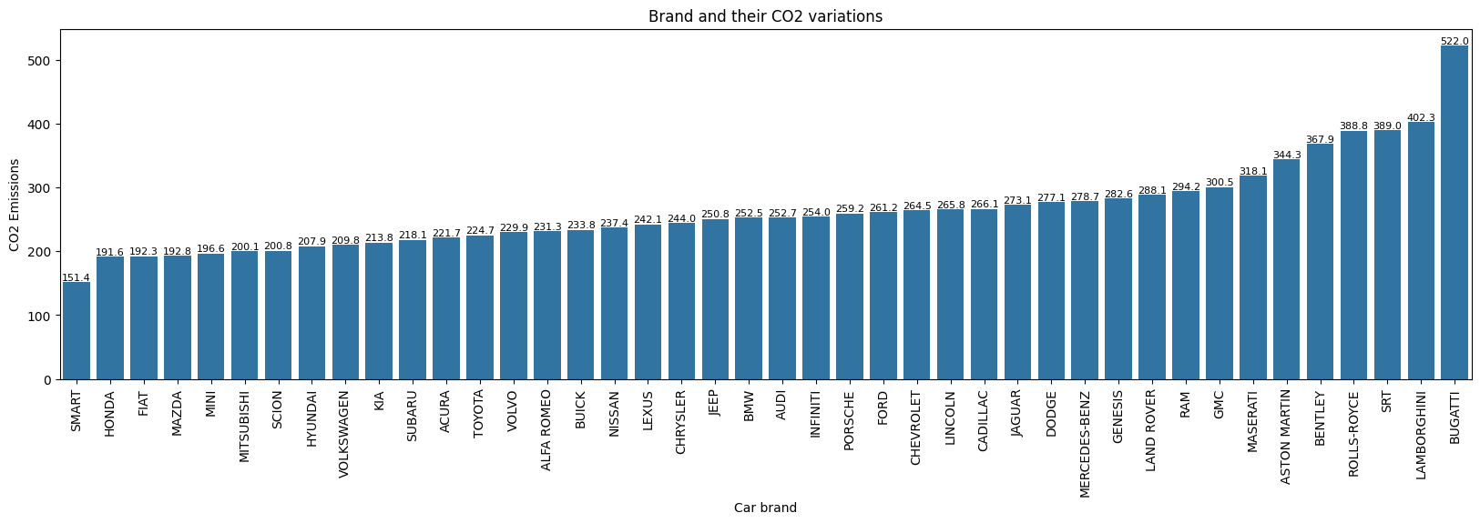
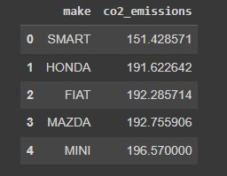
Average CO2 Emissions make
Bugatti has the highest emissions while smart has the lowest emission

Slide 14
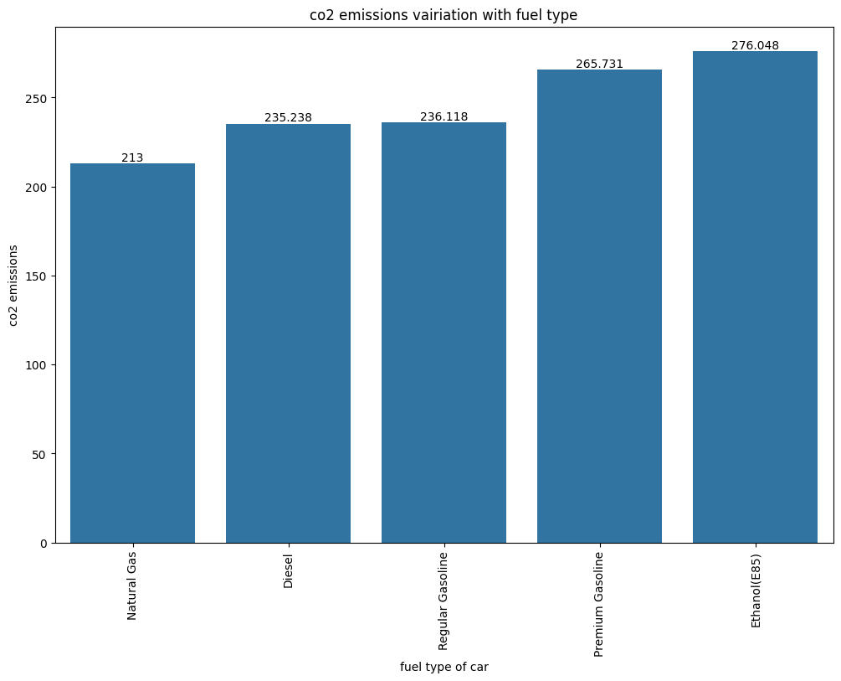
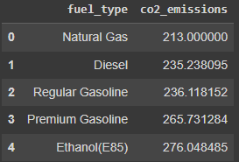
Average CO2 Emissions fuel type
Ethanol has the highest average emissions while Natural gas and diesel have lower average emissions

Slide 15
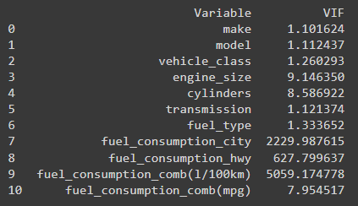
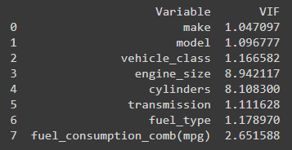
Checking for multicollinearity
Variables like fuel consumption city, fuel consumption highway and fuel consumption combined(1/100km) were removed due to high VIF
Make, model and vehicle class were removed due to low VIF
Standardization of the variables was done and check for multicollinearity was done twice using VIF

Slide 16
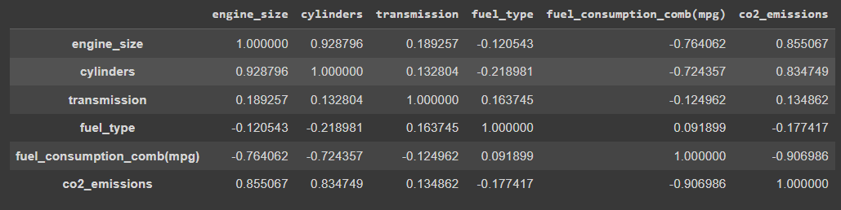
Modelling Considerations
Final variables considered for the model are – engine size, cylinders, transmission, fuel type and fuel consumption combined (mpg)
Normalization of the data is done and test train data is retrieved
X = cars[['engine_size', 'cylinders', 'fuel_consumption_comb(l/100km)',]]
y = cars['co2_emissions']

Slide 17
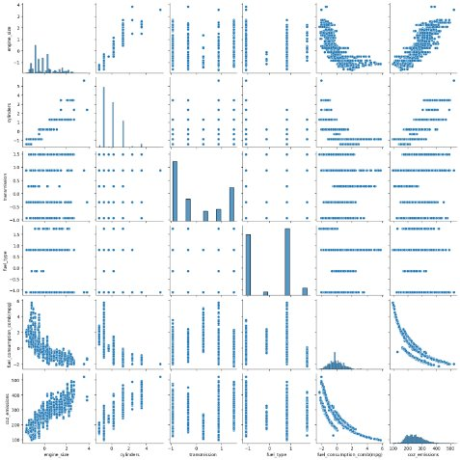
Correlation of the considered variables
The target variable is having a positive correlation with Engine, fuel type, cylinders
Negative correlation with fuel consumption mpg and transmission

Slide 18

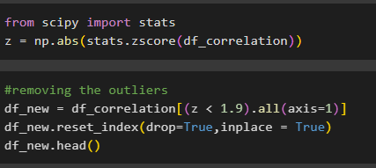
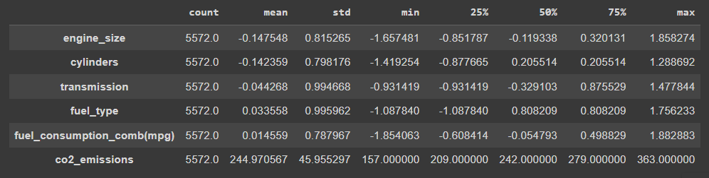
Outliers have been removed and description of the variables required for the models

Slide 19
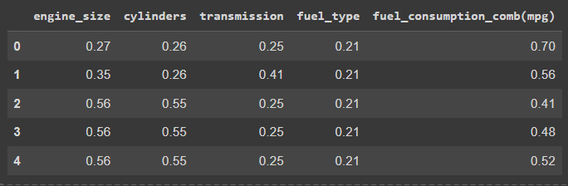
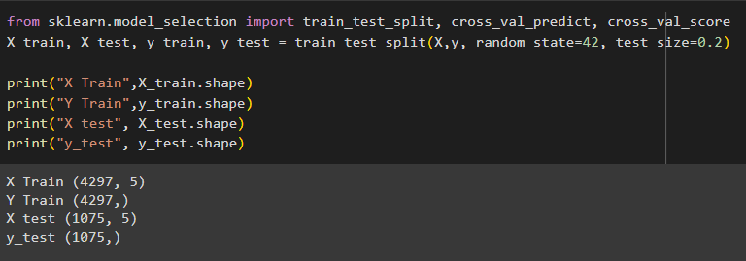
Model preprocessing
Normalization of the model has been done and test train data has been extracted

Slide 20
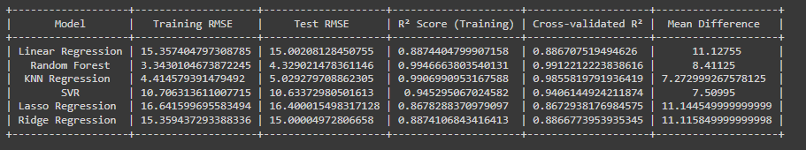
Final comparison
Random forest turned out to be the best model with the highest r.sq value and least rmse value.

Slide 21
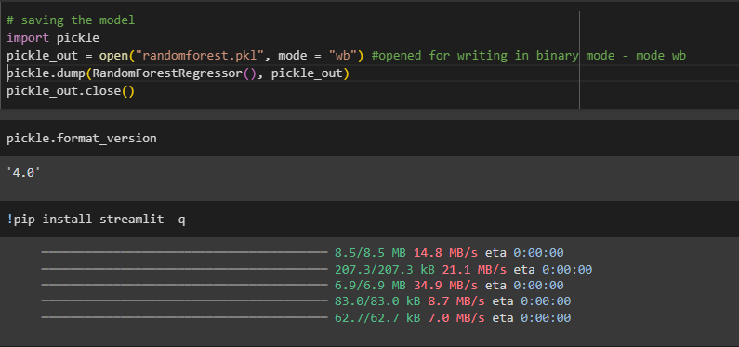
Deployment
Pickle named randomforest has been created and tstreamlit is being installed

Slide 22
deployment
A python file namely emission.py was created to be run by streamlit
The webpage consists of 3 sections
Project details – gives an overview of the project
Visualizations – visually gives us an idea on how the variables affect co2 emissions
Prediction – how the co2 is predicted using the random forest regression model

Slide 23
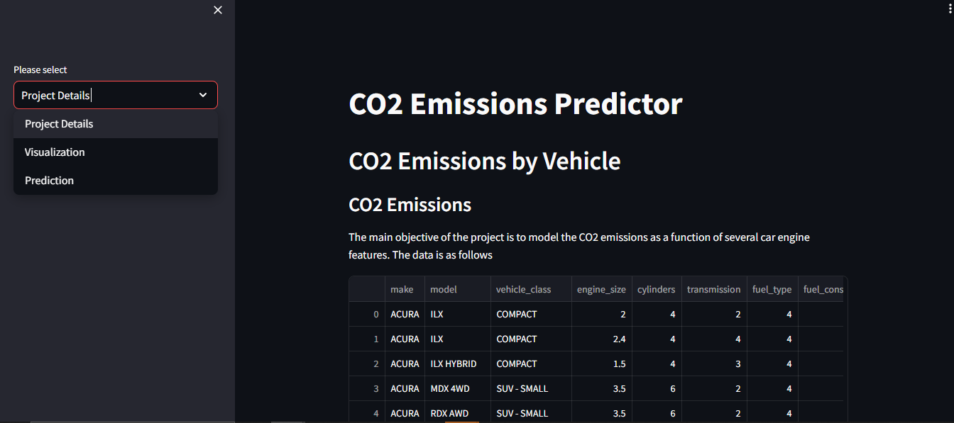
Project detail
The main page displays the project detail along with three options – for shifting to visualizations and predictions

Slide 24
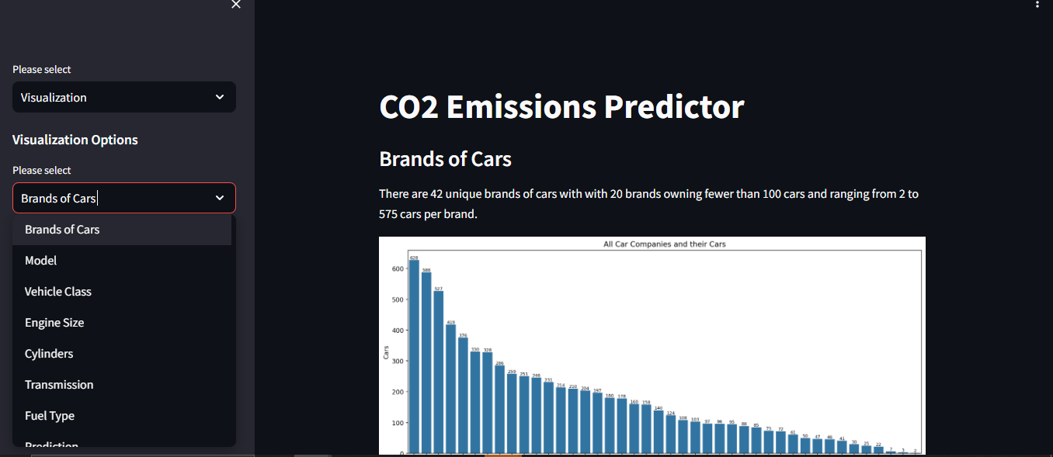
visualization
Has a drop down for the visualizations of effect of each of the variables on co2 emissions

Slide 25
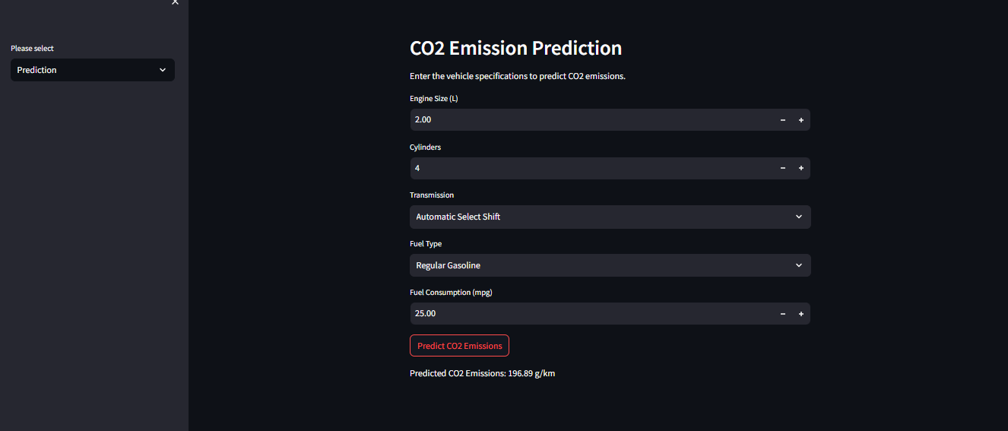
Predictions
Variables through which the models were built have been used in the prediction of co2

Slide 26
Challenges
Data quality and preprocessing – data cleaning, removal of duplicate values, missing values and outliers
Visualization – correlations and effect of the other variables on target variables
Feature engineering – doing the multicollinearity check and removal of unnecessary variables
Model building – evaluating and selecting the appropriate model with having checks on overfitting and underfitting
Model cross evaluation – using kfold method to cross verify if the model selected is fine for deployment
Deployment – Learning how to use streamlit, creating a pickle and deploying without any errors

Slide 27
Thank You
CO2 Emissions – Group 4
Group 4 -
Shanmugam
Abhay Arshid
Shinde Kartik
Nithya Balaji
Hemalatha
Uday Singh Rana

